Slide 1
Kalix Demonstration
Event driven e-commerce

Slide 2




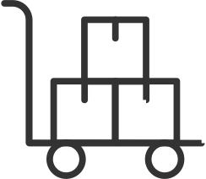
Demo – Event Driven E-commerce
Search Products
Add Item
Check Out
Shopping cart
Products
Item not
available
Checked Out
Update availability (Projections)
Notification
Product stock

Slide 3
Demo – Shopping Cart Service
Add Item
Item Added Event
Shopping cart service
Checked Out Event
Check Out

Slide 4
Development Process
Define data structures (API endpoints & persistence)
Define state model
Code generation tool
Implement business logic
Unit & Integration test
Package & Deploy & Run in production
Test in production

Slide 5
Demo – Shopping Cart Service (Eventing)
Product stock
Checked Out Event
Shopping cart service
Message Broker

